Slide 2
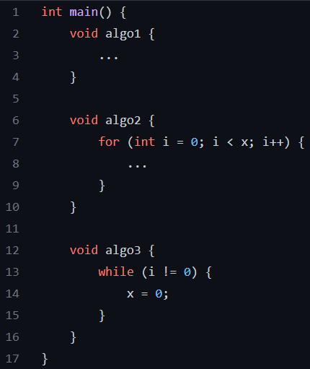

Slide 3
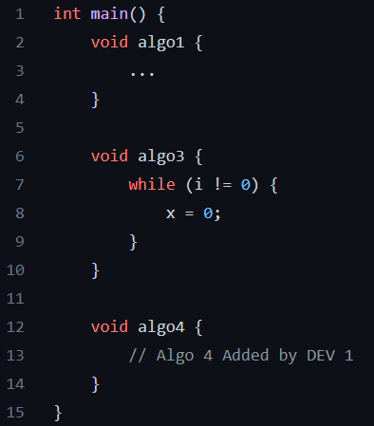
DEV 1 commits and pushes

Slide 4
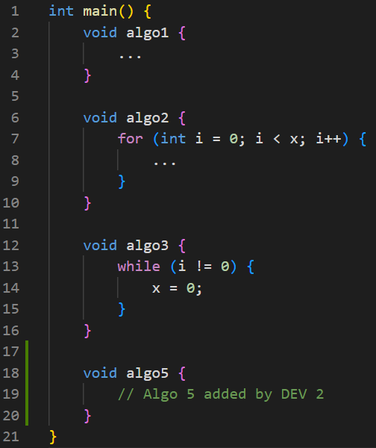
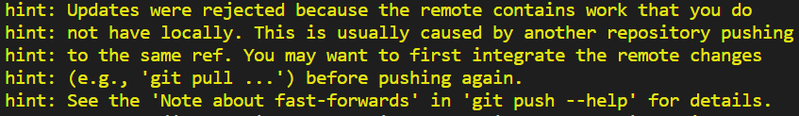
DEV 2 commits
DEV 2 pushes

Slide 5
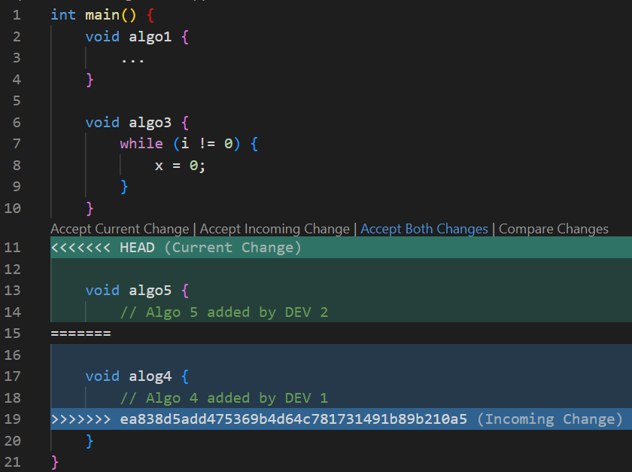
DEV 2 commits and pushes
DEV 2 pulls

